Slide 1
FABULOUS
CUSTOMER DATA ANALYSIS

Slide 2
INTRODUCTION
Every business owner and company wants to improve their Sales to earn more profit. To achieve this, a thorough analysis of sales records will play a vital role in it.
Knowing where your target customers are, determining which of your products customers enjoy the most, which among the products yield high returns, and many others.

Slide 3
PURPOSE
To determine the performance of the company
sales trend
Profit vs sales.
Average day of delivery
To know who the target customers are.
Where do they come from?
What do they buy most?
Which mode do they use most?
Age range of the target Customer.

Slide 4
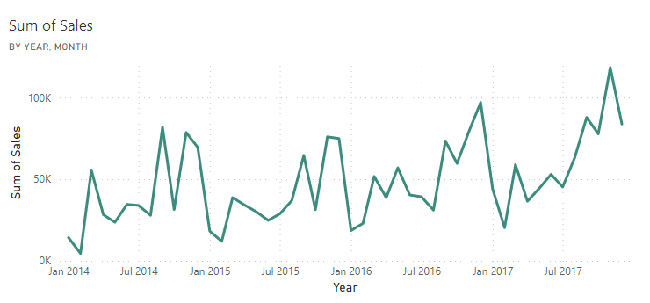
PERFORMANCE
SALES TREND
Although, it is an upward trend but there is a seasonal variation in the sales trend. It hits the ground every January before rising up again.

Slide 5
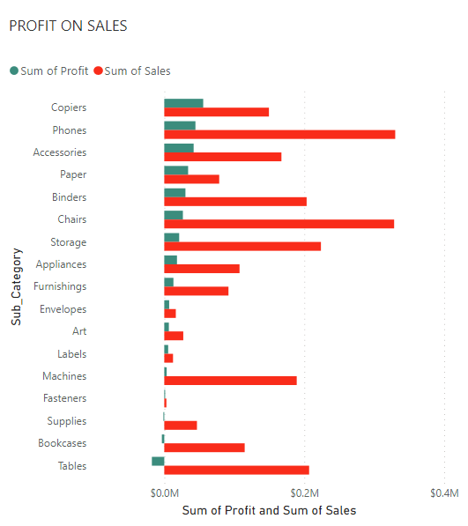
PROFIT
PROFIT BY SALES
Copiers come with more profit follows by phone sales.
The sales of Bookcases and Tables are ending in loss for the company.

Slide 6
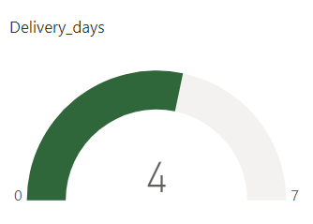
DAY OF DELIVERY.
On an average, every customer gets their product after 4 days
If nearby, or falls on the day of delivery the customer gets his product that day.
The longest time it takes to deliver a product is 7 days

Slide 7
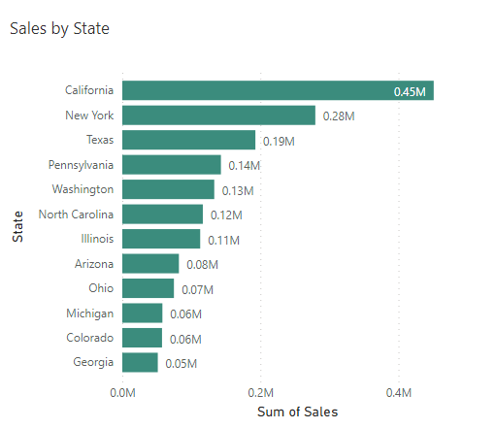
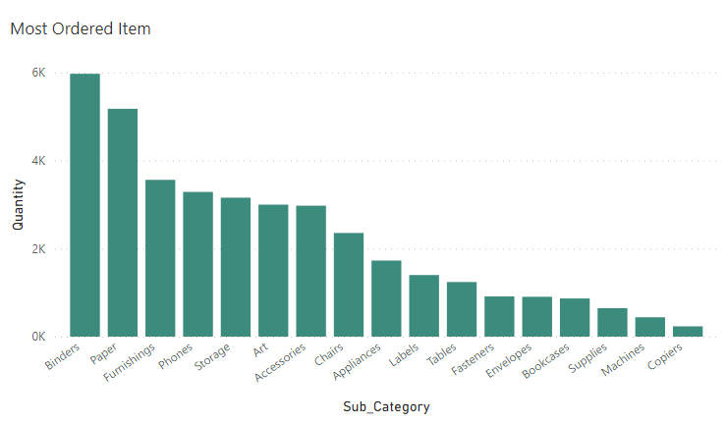
WHERE AND WHAT ARE THEY BUYING?
TOP 12 STATES MOST ORDERED ITEM

Slide 8
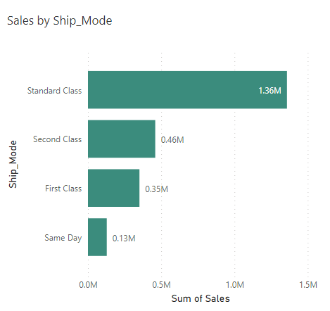
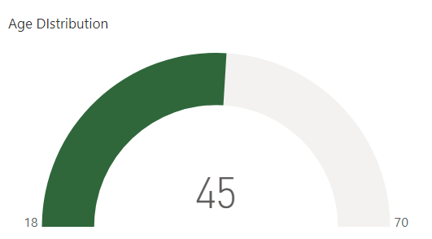
MODE AND AGE RANGE OF CUSTOMERS
SALES BY SHIP MODE AGE RANGE
MINIMUM AGE IS 18 YEARS OLD
MEDIAN AGE IS 45 YEARS OLD
MAXIMUM AGE IS 70 YEARS OLD.

Slide 9
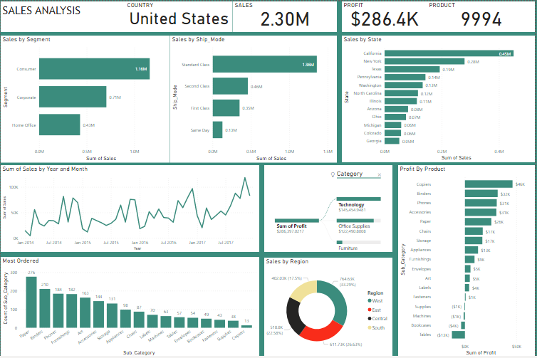
MINI DASHBOARD

Slide 10
CONCLUSION
The analysis reveals where the company needs to focus on: The lapses and the strength.
The lapses
The sales trend comes down every January.
The sales of Bookcases and Tables are ending in loss for the company.
The strength
There are many customers in California than other state.
Technology product like phones, yield more income for the company.
Standard class is the most used ship mode.

Slide 11
RECOMMENDATION
The Research team should find out why the sales often go down every January and make a necessary report to aid adjustment.
The sales of table and bookcases should be taken care to stop the loss.
Company should venture into more technology-product as it comes with more sales and profit.

Slide 12
REFLECTION
Domain knowledge is a key aspect of data analysis, this will help the analyst in determining the most important aspect of the data. With domain knowledge, the analysis can still be better.
Slicer was not added to the dashboard because the visualization will be static in the slides.

Slide 13
REFERENCES
Report page
https://app.powerbi.com/groups/me/reports/d7d14af4-addb-4453-8bf0-cbee145395db/ReportSection

